Slide 1
English Writing II
Week 10 Argument and counterarguments

Slide 2
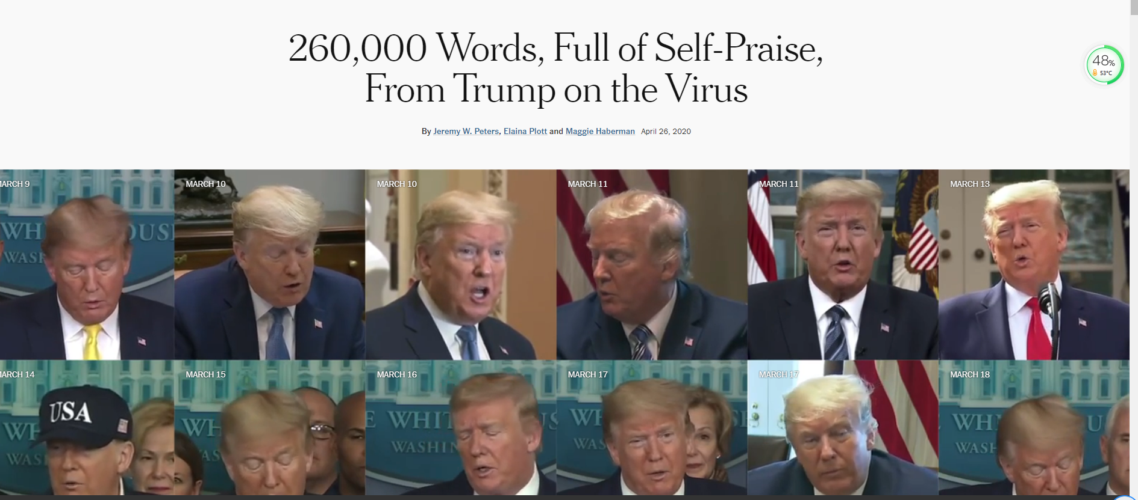

Slide 3
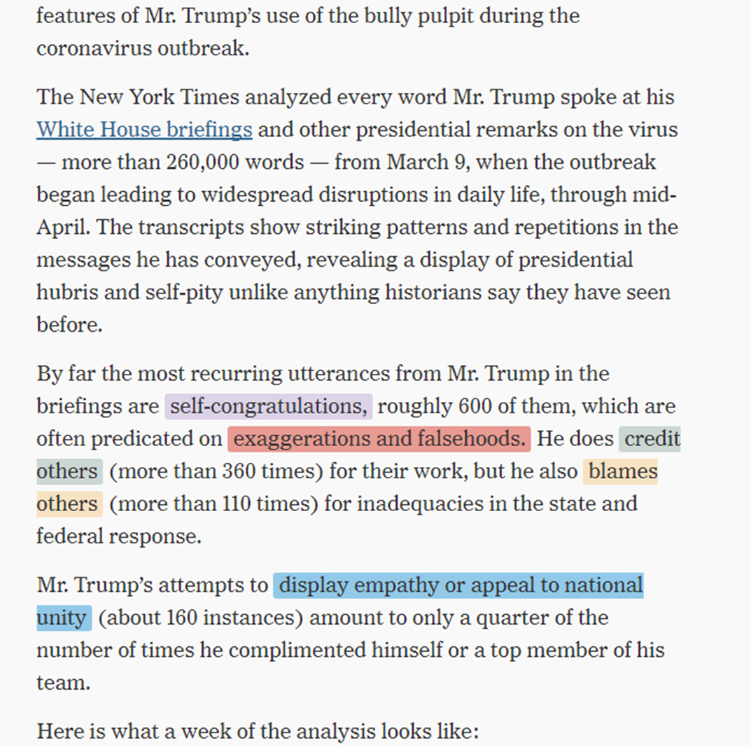

Slide 4
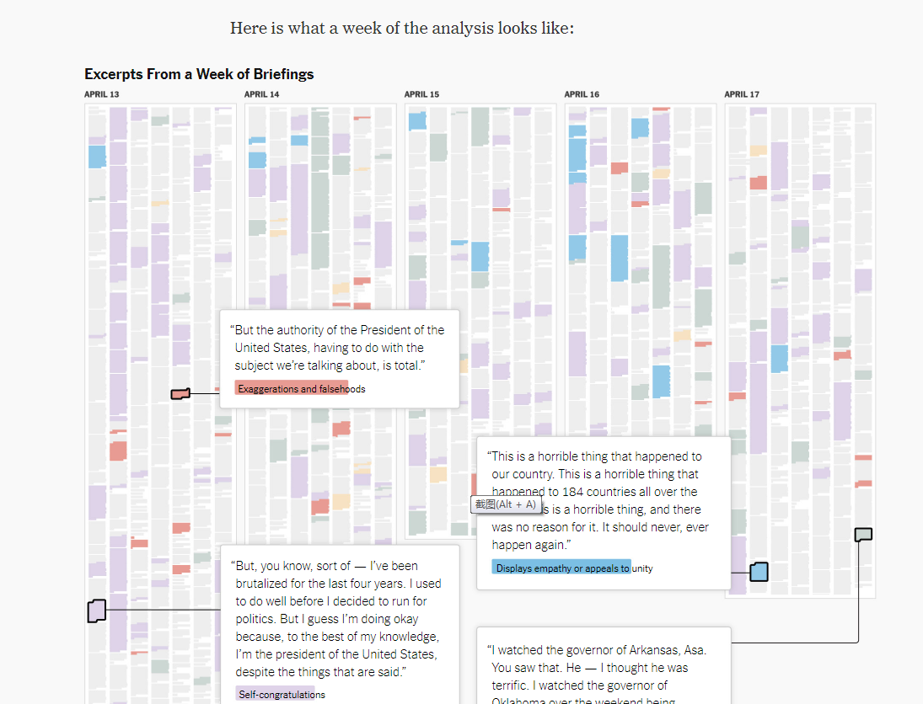

Slide 5
In today’s lesson
Review of the outline writing
In-class reading: A Word to Youth
Writing technique: Counterargument and rebuttal
In-class writing exercise 1001

Slide 6
Outline 1
Perspective: Technology Focus: The Digital Divide
Main idea: In the 21st century, internet access is a necessity, a human’s right; Internet should not be a privilege; Equality
Supporting Evidence:
→ 46.4% of the world’s population lack internet services; As information shifts towards the online platform, people w/o the internet will be left out; The pandemic highlights this problem, as work and education move online; People w/o the internet cannot use food delivery services, exposing themselves to the virus

Slide 7
Outline 1 (continued)
Extended explanation:
→ The way of human interaction is likely to change after the pandemic (e.g. no mass gatherings; stay at home); Learning or working from home is likely to persist; The internet is a fast and effective way to receive urgent information and knowledge; People with mental health problems can stay connected to friends and family, reducing feelings of isolation; Those without the internet will be at a huge loss; The gap between the rich and the poor will widen; The next pandemic is not a matter of if but of when, and social distancing will be an inevitable remedy

Slide 8
Outline 2
Perspective: Medical Education
Focus: The changes that colleges should make in medical education after Covid-19
Examples: 1. The imbalance between different branches of medicine will be reduced When facing academic specification among medicine, most students tend to choose department of cardiology, obstetrics and gynecology, etc. However, the lack of medical staffs in the department of infection has made it harder to fight against Covid-19. (Zhu Lin et al, China Medical Education Technology.2020) Therefore, governments and colleges should adjust the specialty settings.

Slide 9
Outline 2 (continued)
2. Strengthen medical research. Scientific research plays an important role in the fighting against Covid-19. The scientific findings could lead to earlier production of drugs and vaccines.
3. Pay more attention on medical humanities education. Some doctors ran away from the pandemic, while some volunteers offered to join the fighting. Therefore, teachers should take the phenomenon during Covid-19 as vivid examples to enhance medical humanities education and improve students’ humanistic care as doctors.

Slide 10
Outline 3
Perspective: personal life and culture
Focus: the reason why westerners dislike wearing face masks whereas the populace in eastern Asia are scrambling for face masks.
Examples:1. Almost no governments in western countries encourage citizens to wear masks. 2. Governments in China, Korea, Japan all persuade the public to wear face masks.3. In many cities like New York, even when virus outbreak has developed to a very severe extent, still nearly half of citizens walking on roads did not wear face masks.

Slide 11
Outline 3 (continued)
The weight: 1. the difference in the history of facial wearings such as sunglasses, hat compared to that of face masks 2. the behavior of westerners in early cases of virus outbreak like the Spanish Flu and the Black Death. 3. a cultural difference between the Eastern Asia and the West( collectivism and individualism)

Slide 12
Other outlines
The covid-19 pandemic will brought about boom in online education such as live-streaming teaching and recorded broadcast classes.
Students are less willing to study abroad .
Revived trust in institutions
The power of music
People care more about good personal hygiene habits

Slide 13
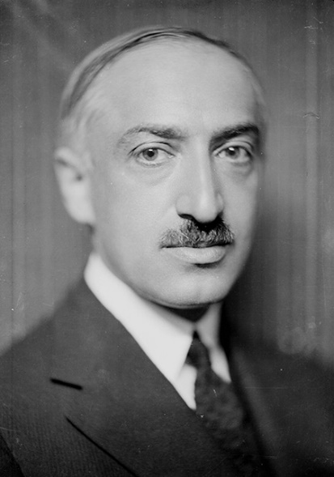
Sample reading
A Word to Youth, by Andre Maurois (1885-1967)
A Word to Youth (Week 10).docx

Slide 14
Counterargument and rebuttal
Counterargument is a presented position that contradicts or undermines the thesis of an essay.
Rebuttal is the act of refuting something by making a contrary argument, or presenting contrary evidence.

Slide 15
Counterargument
To anticipate doubts and preempt objections from skeptical readers
To weigh alternatives before arguments, to confront difficulties rather than dodge them
To show that you are more interested in finding the truth rather than winning a point.

Slide 16
Clear indicator of the transition
granted, however, although, while it's true, nobody denies, true, on the other hand, the opposition might say, a common argument against this is, nevertheless, to be sure.

Slide 17
How to response to a counter-argument?
To understand the opposite view
Response 1: Irrelevance (“That’s not the point here”)
Response 2: Rebuttal (“Wrong”)
Response 3: Concession (“Yes, but…”)

Slide 18
Counterargument and rebuttal
[Argument] A man or women … has more power to face affliction.
[Counterargument] “A wretched power…. A power made of indifference and skepticism”
[Rebuttal] The youth is mistaken. Men and women who have reached their maturity have not become indifferent. …

Slide 19
Counterargument and concession
[Counterargument]: “The hollow optimism of words,” some will think.
[Concession] In present sorrow the mere abstract idea of future relief is comfortless. But life itself shows us the way to more active solace.

Slide 20
Summary: Counterargument
Be wise, tolerant, thoughtful and open-minded
Explore the possibilities to strengthen your case
Help the reader to understand the tensions & contradiction.
A dialogue is more engaging and persuasive.
Argue, don’t claim. (Show, don’t tell)

Slide 21
In-class writing 1001 (15 minutes)
Model: paragraph 3-4
A clear thesis statement
A plausible counterargument
An effective and logical rebuttal

